Slide 1


Blazor C# running in the browser via WebAssembly
Scott Sauber
Slides up at scottsauber.com
scottsauber
Notes:
ToDoMVC
Electron
Build before
Delete Local Sotrage

Slide 2
Audience
Mostly targeted for .NET developers
JS Developers interested in WebAssembly
scottsauber

Slide 3
Agenda
What is WebAssembly?
What is Blazor?
How does Blazor work?
Demos
Questions
scottsauber

Slide 4
Purpose
Differentiate what is Blazor vs WebAssembly
Get excited for the future
scottsauber

Slide 5
Who am I?
Software Consultant at Lean TECHniques
Primarily .NET/JS Developer
React fanboy
Enjoys writing JavaScript
Blog primarily on ASP.NET Core on scottsauber.com
Author of Blazor Snippets for VS Code
scottsauber

Slide 6





















Current State of the SPA Front End
Pick a Language:
Pick a Framework:
Pick your tools:
Common

Slide 7
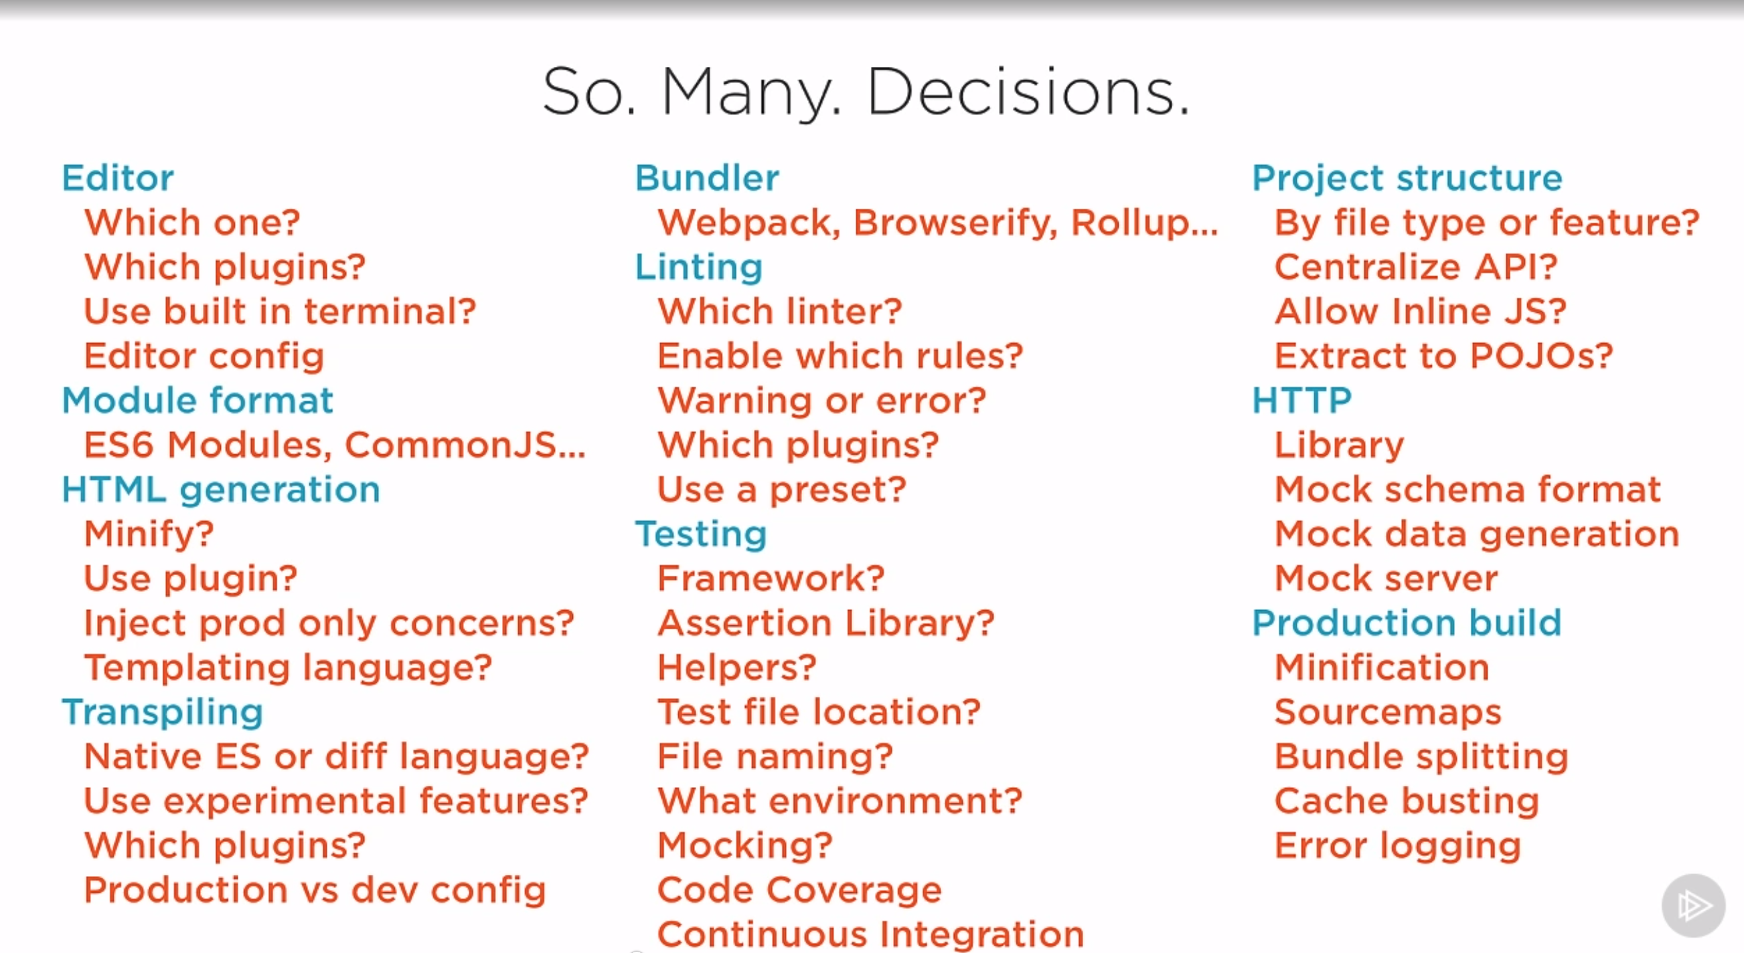
Source: Cory House’s Building a JavaScript Development Environment Pluralsight course

Slide 8

At the end of the day….

Slide 9
Problems
Whole host of people don’t like JS
Dynamically typed
Less integration, more stitching
Browser support
Moves too fast, lots of choice, intimidating
node_modules
SPA’s are more expensive to maintain
Front-end + Back-end team
Training up full stack to be great at both (very difficult)
When using a different language than JS on the backend…
Duplicate Business Logic (like validation) or just have server
No IDE/compiler help between backend models + front end making AJAX calls
Unless bringing in yet another tool (GraphQL, TypeScript/C# syncer, etc.)

Slide 10
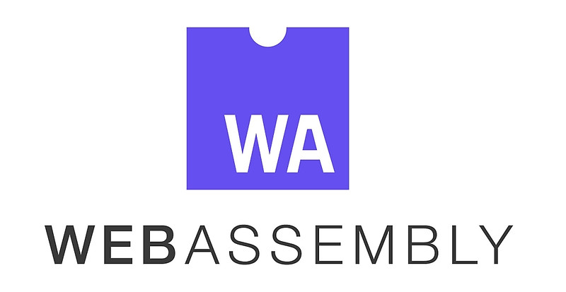
What is Web Assembly (WASM)?
WebAssembly (WASM) is a low-level binary format language that can be run in modern web browsers that runs at near-native speeds.
Compilation Target for other languages
Browser standard
No more JS monopoly

Slide 11
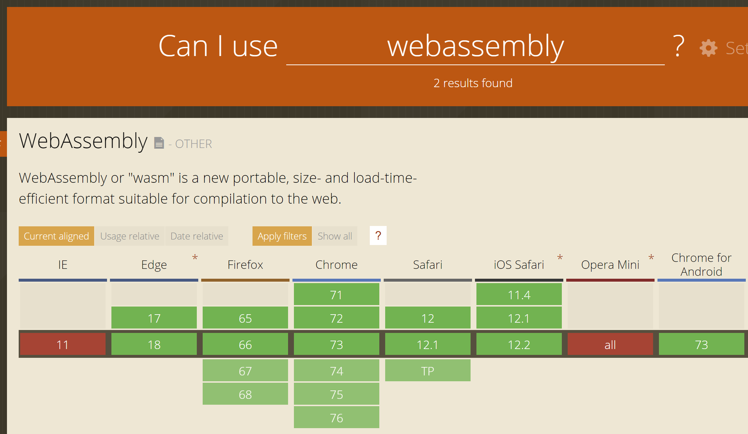
Is WASM Ready?
And you can polyfill WASM with asm.js!

Slide 12
What is Blazor?
Blazor is a .NET SPA framework (currently in Preview) maintained by Microsoft using C# and HTML that runs in the browser via WebAssembly….

Slide 13

Wait a second….
It’s a Standard, not a plugin!

Slide 14
What is Blazor?
Blazor is a .NET SPA framework (currently in Preview) maintained by Microsoft using C# and HTML that runs in the browser via WebAssembly….
Uses Razor syntax
Browser + L + Razor = Blazor
Uses component-based architecture
Runs on top of Mono
Blazor == UI Framework == MVC or Web Forms
Mono == Runtime == .NET Framework or .NET Core
Development led by Steve Sanderson, of KnockoutJS fame

Slide 15
Was Experimental – Now Committed & Preview
“... With this newest Blazor release we’re pleased to announce that Blazor is now in official preview! Blazor is no longer experimental and we are committing to ship it as a supported web UI framework including support for running client-side in the browser on WebAssembly…”
.NET Core 3.0 Preview 4 announcement

Slide 16

So I can write C# in the Browser!?!
Blazor is .NET Standard 2 compliant
However, not all .NET Standard 2 API’s are implemented running in browser make sense
Examples
System.Net.Mail
System.IO
These throw Platform Not Supported exceptions
But a lot do make sense
HttpClient => AJAX

Slide 17
Blazor Provides Calling C# from JS + vice versa
C# Wrappers on top of JS API’s
LocalStorage
PaymentRequest
Or any npm library
C# maps to JS pretty well
async/await
Task => Promise

Slide 18
Why would you be interested in this?
C# is a fantastic language
…not that JavaScript isn’t…but statically typed languages are winning (see: TS, Flow, Reason, etc.)
46% of respondents to npm survey are using TypeScript
ASP.NET Core performance
#7 on TechEmpower
8x faster than Node, 1.5x faster than Netty (Java), 47x faster than Django (Python), 7x faster than Kotlin, etc.
Share logic with existing .NET backend
Validation logic
Models from Server when retrieve from the Client
Consolidate frontend and backend teams under one language

Slide 19
Demo #1
Hello World on Blazor
Component Architecture
Dependency Injection
Sharing logic
scottsauber

Slide 20
Rapid Fire Questions
How big is it?
2.4MB
Very little work done thus far to optimize
Do WASM files cache like JS and CSS files?
Yes
How does it work under the hood?

Slide 21
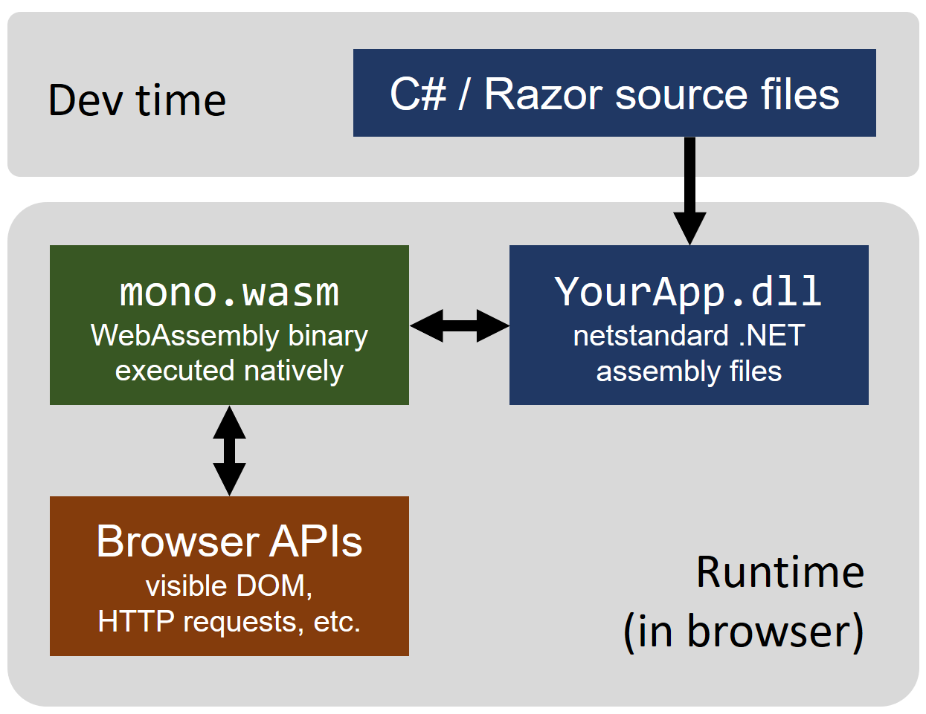
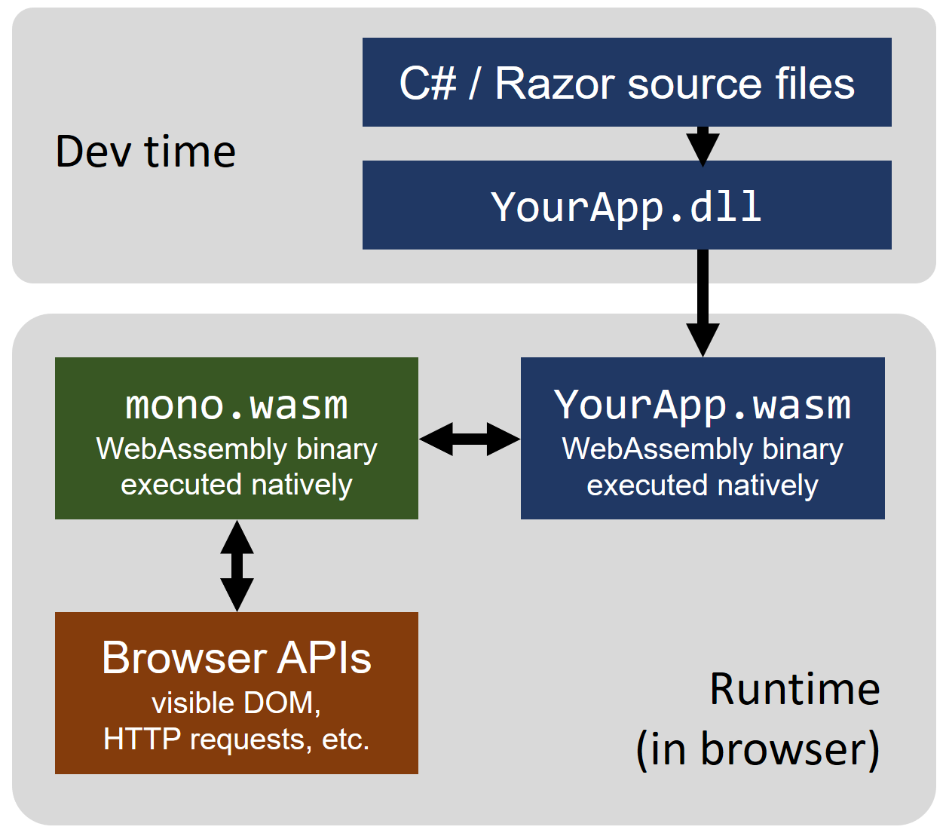
How does Blazor work?
Today
Future
Source

Slide 22
Why Mono? Why not .NET Core?
Already Client-side-focused
Xamarin, Unity, etc.
.NET Core is Server-side-focused
Already developed for unique platforms (iOS, watchOS, PS4, etc.)
Already had linker (DLL trimmer/tree shaker) for Xamarin
They got it working first
Long term it will run on .NET 5
.NET 5 unified framework for Core, Mono, Full Framework. Single runtime to target for Mobile, Web, Desktop.
scottsauber

Slide 23
Demo #2
LocalStorage C# Wrapper
Code: https://github.com/scottsauber/BlazorToDoMVC
scottsauber
Notes:
Install Cloudcrate.AspNetCore.Blazor.Browser.Storage
services.AddStorage(); @inject LocalStorage Storage

Slide 24
What else can we do?
Blazor’s component model is de-coupled from the Browser
…so…

Slide 25
What else can we do?
Blazor on Electron
Cross-platform desktop framework. Write once, run anywhere.
Proof of Concept Running on .NET Core
Why?
Faster Code Execution
Full Debugger in VS
.NET Core instead of Mono
Access to Desktop API’s

Slide 26
Demo #3
Blazor on Electron
Electron.App
Code: https://github.com/SteveSandersonMS/BlazorElectronExperiment.Sample
scottsauber

Slide 27
What else can we do?
Blazor on the Server
Feels client-side
Changes streamed via WebSocket
Why?
Small bundle (~400KB)
Code runs on .NET Core server, no constraints
Full Debugger in VS
Why not?
More load on server
Does not support disconnects

Slide 28
Demo #4
Blazor on the Server
scottsauber

Slide 29
Blazor 3rd party Components
Telerik
Syncfusion
DevExpress

Slide 30
Current Status - What’s there?
Component Model
Routing
Layouts
Dependency Injection
JS interop
Share Components between projects
Debugging in Chrome – Shift + ALT + D
Forms and Validation
VS and some VS Code support
Blazor Server-Side
Server Side Rendering

Slide 31
Current Status - What’s coming?
Better tooling
Hot reloading
AOT
Smaller bundle size
AuthN + AuthZ work
Debugging in VS

Slide 32
Source: Cory House’s Building a JavaScript Development Environment Pluralsight course

Slide 33
The remainder of these you’ve likely already decided on the backend!
Source: Cory House’s Building a JavaScript Development Environment Pluralsight course

Slide 34
Current State of the SPA Front End
Pick a Language:
Pick a Framework:
Pick your tools:
Common

Slide 35












Future State of the Front End? (besides JS)
Pick a Language:
Pick a Framework:
???
Pick your tools:

Slide 36
Future
Currently 3.0 preview5
Client-side Blazor is NO LONGER experimental and will be shipped sometime in the future.
Server-side Blazor will ship with .NET Core 3.0 later this year.
I wouldn’t bet my company on Blazor just yet

Slide 37
Takeaways
WASM is AWSM
Potential of Blazor
WASM has potential to radically disrupt WebDev
Start thinking about “would this code run ok in the browser?”
Separate domain + input validation

Slide 38
How do I get started?
Today:
.NET Core 3.0 Preview 4 SDK (3.0.100-preview4-011223)
Visual Studio 2019 (Preview 4 or later) with the ASP.NET and web development workload selected.
The latest Blazor extension from the Visual Studio Marketplace.
The Blazor templates on the command-line:
dotnet new -i Microsoft.AspNetCore.Blazor.Templates::3.0.0-preview4-19216-03
Future:
NET Core 3.0+
VS/VSCode/whatever
Slides at scottsauber.com

Slide 39
Resources
https://blazor.net
Microsoft Documentation
https://learn-blazor.net
Community-led Documentation
https://github.com/aspnet/blazor
Blazor Source Code
https://github.com/mbasso/awesome-wasm and https://github.com/appcypher/awesome-wasm-langs
Lists of what other languages are doing with WASM
Slides at scottsauber.com
scottsauber

Slide 40

Questions?
Slides at scottsauber.com
scottsauber

Slide 41
Thanks! Don’t forget PubConf party at Amsterdam Bar & Hall right now
Slides at scottsauber.com
scottsauber

